Slide 1


Course :
AI Foundation for ALL
Instructors :
Alok Gupta
Mansi Jain

Slide 2
Agenda
This graphic uses SmartArt.
Click on SmartArt to edit text. You can add or delete “points”
You may change formatting per individual object
To add numbers to dots, ungroup the SmartArt NOTE: Step 3 breaks SmartArt
Myths about AI/ML​
Overview of ML
Commonly Used Tools / Framework​
AIML Use Cases & Solutions from Optum​
AIML PaaS​
Understanding Jargons​

Slide 3
Myths About AI/ML
Myth | Reality
AI and ML are the same | Related but not the same. ML is a subset of AI
ML Systems are completely self-sufficient | No. Every now and then every new learning needs to be validated
Singularity, AI will take over and dominate humanity | It’s not a one shoe fits all - there is no machine learning algorithm that can solve every problem. Each AI solution has a very particular and narrow use case and hence in many cases, combination of multiple algorithms can be used which is again use-case centric.
In the future, robots will take over our jobs | No complete data set or digital representation of everything that a human can do and never will be (starting from emotions to economic and through to social value-based activities).

Slide 4
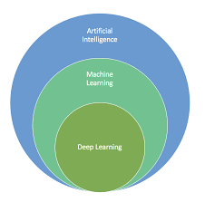
Understanding Jargons
Artificial Intelligence: It is the intelligence demonstrated by machines, in contrast to the natural intelligence displayed by the humans.
Machine Learning: Field of computer science that uses statistical techniques to give computer systems the ability to “learn” with data without being explicitly programmed.
Deep Learning: A technique to perform machine learning inspired by our brain's own network of neurons.

Slide 5
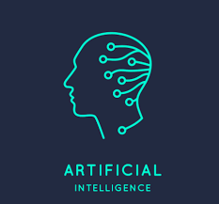
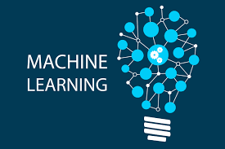
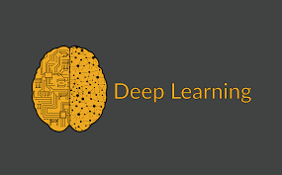
Example of AI-ML-DL
Self-driving Cars
Sign and Voice Recognizer (SVR)
Sophia - The Humanoid Robot
Snapchat Filters
Netflix - The application that knows what you want
Language Translation - Google Translate
Gmail Smart Compose and Google Photos Color Pop

Slide 6
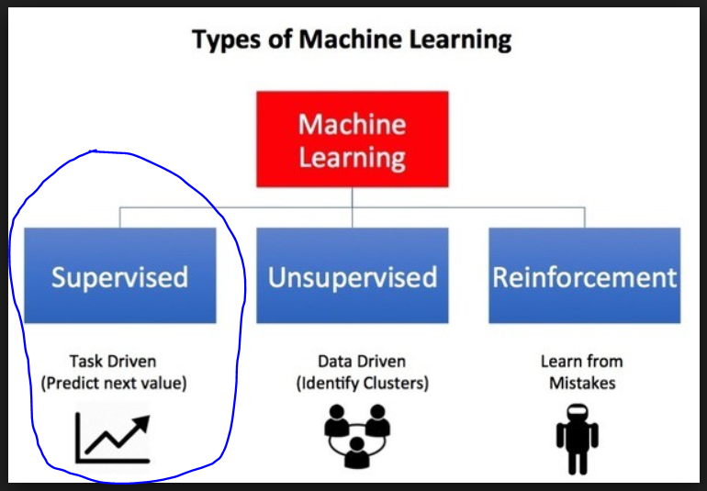
Types of Machine Learning
Notes:
Add in Techno Leader slide deck as well.

Slide 7
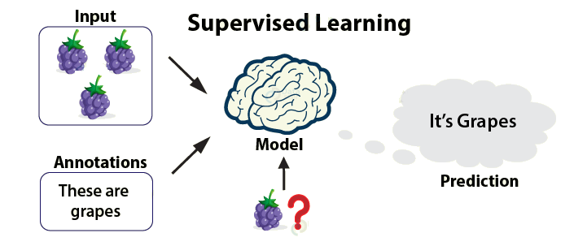
Supervised Learning

Slide 8
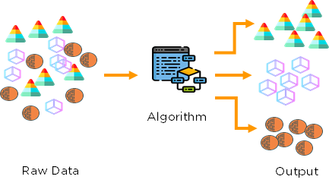
Unsupervised Learning
Clustering

Slide 9
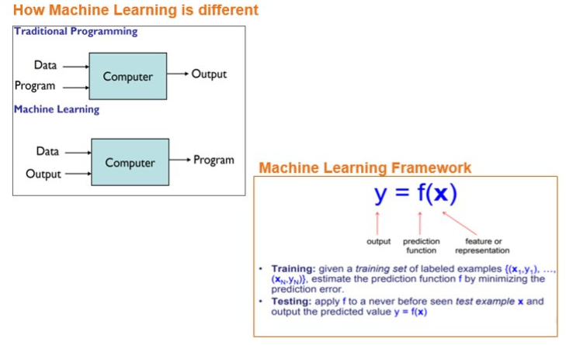
Traditional Programming Vs ML

Slide 10
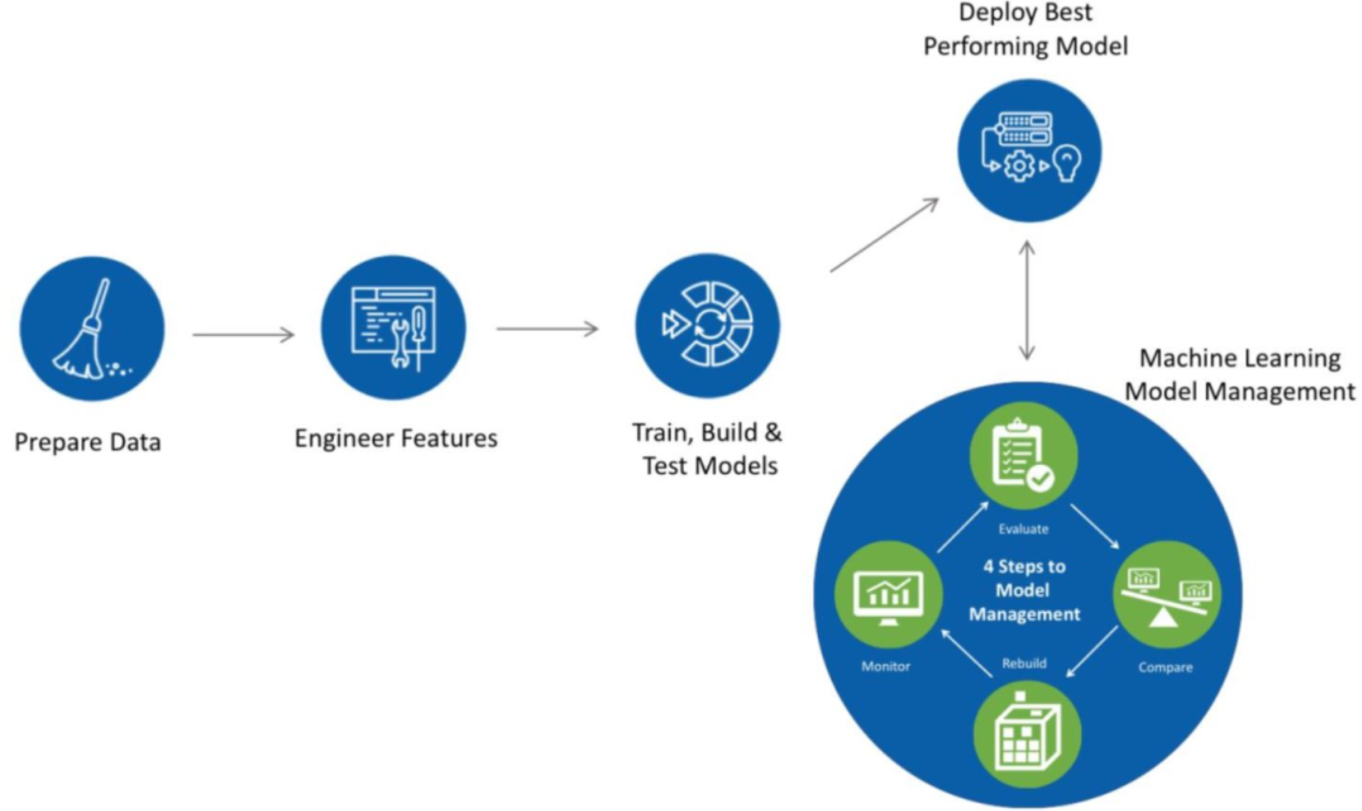
Machine Learning Model Building/Management Process
Notes:
Add in Techno Leader slide deck as well.

Slide 11
Commonly Used Tools / Framework
Tools | Purpose
Python | Programming Language
Pip/Conda | Package managers
Python Libraries | Libraries (Pandas, Numpy, Matplotlib, Seaborn, Scikit Learn) for data wrangling/munging, mathematical operations, AIML Algorithms, charting, etc.
Jupyter/PyCharm | IDE
Gunicorn | WebServer
Flask, Django, Tornado, Pyramid | Web Frameworks for Python
OptumIQ | Optum provided platform for machine learning model development, model deployment, and model monitoring
Azure ML/ AWS/ Openshift /K8 | Deployment Environment

Slide 12
AI/ML Use Cases
Email filtering: AI is used to filter out the incoming emails and categorize them based on the content if they are spam or not. With a huge number of emails, the system is trained in such a way that they learn how to differentiate the spam emails from non-spam.
Fraud Detection: Banks and financial institutions use artificial intelligence techniques and algorithms to identify the suspicious entities, fraud and activities in the financial system. Moreover, authorized access is ensured by identifying entities using facial recognition technology in which Artificial intelligence is used.
Personalization: To personalize the online experience, artificial intelligence is used. AI models learn from your browsing history and interests and show you the ads accordingly. Services like Netflix and amazon learn and show relevant information.
Speech recognition: Speech recognition functions are deployed using artificial intelligence that detects the vocals of individuals and identifies a person. Most of the applications are now available that have speech recognition feature such as Siri and Alexa.

Slide 13

AI/ML Solutions from Optum (Use Case 1)
COB WOW Primacy Determination:
Problem Statement
Delay of primacy determination to identifying who is the primary Payer, causes overpayment and hence need arises to recover in retrospective cycle.
The Coordination of benefits contributes to ~40% of savings for UHG Optum Payment Integrity, by identifying who should be the primary payer for any member.
Presently the true positive accuracy of primacy flagging is ~40% (0.7 million), and to identify this investigator has to go through all 100% inventories (1.7 million) of primacy identified by current prioritization process. This results in delay of primacy determination.
Solution : Proposed Machine Learning approach to predict and prioritize the potential cases first to prevent the delay in primacy determination.
Improvement (Savings): $24M
Challenges : Data Collection for Model training, Model deployment, convincing existing analytics that we are not replacing existing SAS algorithms rather putting additional ML layer for improvement.
For Use Cases Details Go to :
https://github.optum.com/agupt38/reuse_aiml/tree/master/Use%20Cases
Current Weight Base ~40%
ARO
COB - WOW
Future Machine Learning ~90%
Notes:
The Five Ws :
Who will:
Use your idea : Coordination of Benefits
Pay for your idea : Business from COB WOW
Deliver and sell your idea : PEDS team Better work force management
Compete against your idea : Predication of the payer recovery can be automated on any case management system
What is your idea (system, product, process, service, etc.) and what does it look like? – Upgrade the WOW prioritization part to predict based of the machine learning model
What competition exists for this idea? : Not identified
When do you think users will want it and when do you think it could be delivered? ASAP
Where should it be delivered, (in the cloud, hosted, or premise-based for products) as face-to-face services, in the doctor’s office, etc.? Cloud
Why:
Is Optum well-positioned to deliver this solution? Yes
Would people want to pay for your solution? Yes
Would users want to use your solution? Yes

Slide 14
AI/ML Solutions from Optum (Use Case 2)
Provider call prediction :
Problem Statement
In a year there are ~35M calls handled from providers
There are 100+ operations applications to handle providers
6000+ call advocates
The impact of above are:
The projected cost for handling provider calls is ~$35M+
This will impact NPS as providers have to call UHC for more info or appeals
Solution : Adopted Machine Learning approach to :
Predict the probability of a call for a claim and proactive action accordingly, like provider education, notify provider with all details of the eligibility and payment criteria based on EOB
Predict the probability of Long Call and take appropriate action to prevent or shorten the call. Identify specific providers where the scenario observed or specific cases
Improvement (Savings): ~$35M+
Challenges : Claim and Providers data merging and transformation for EDA and Model Training, Hard to improve the accuracy beyond 82% since data was highly imbalanced.
Notes:
The Five Ws :
Who will:
Use your idea : Providers and Payers
Pay for your idea : Providers and Payers
Deliver and sell your idea : Data Viz Community work force management
Compete against your idea : Market providers and payers
What is your idea (system, product, process, service, etc.) and what does it look like?
Predict why and when someone is calling our help center on a provider’s behalf using call, claim and provider profile data and machine learning which will improve the provider experience :
Reach out to providers before they call
Identify education for our providers
Design improvements to our technology and tools.
Where should it be delivered, (in the cloud, hosted, or premise-based for products) as face-to-face services, in the doctor’s office, etc.? Cloud
Why:
Is Optum well-positioned to deliver this solution? Yes
Would people want to pay for your solution? Yes
Would users want to use your solution? Yes

Slide 15

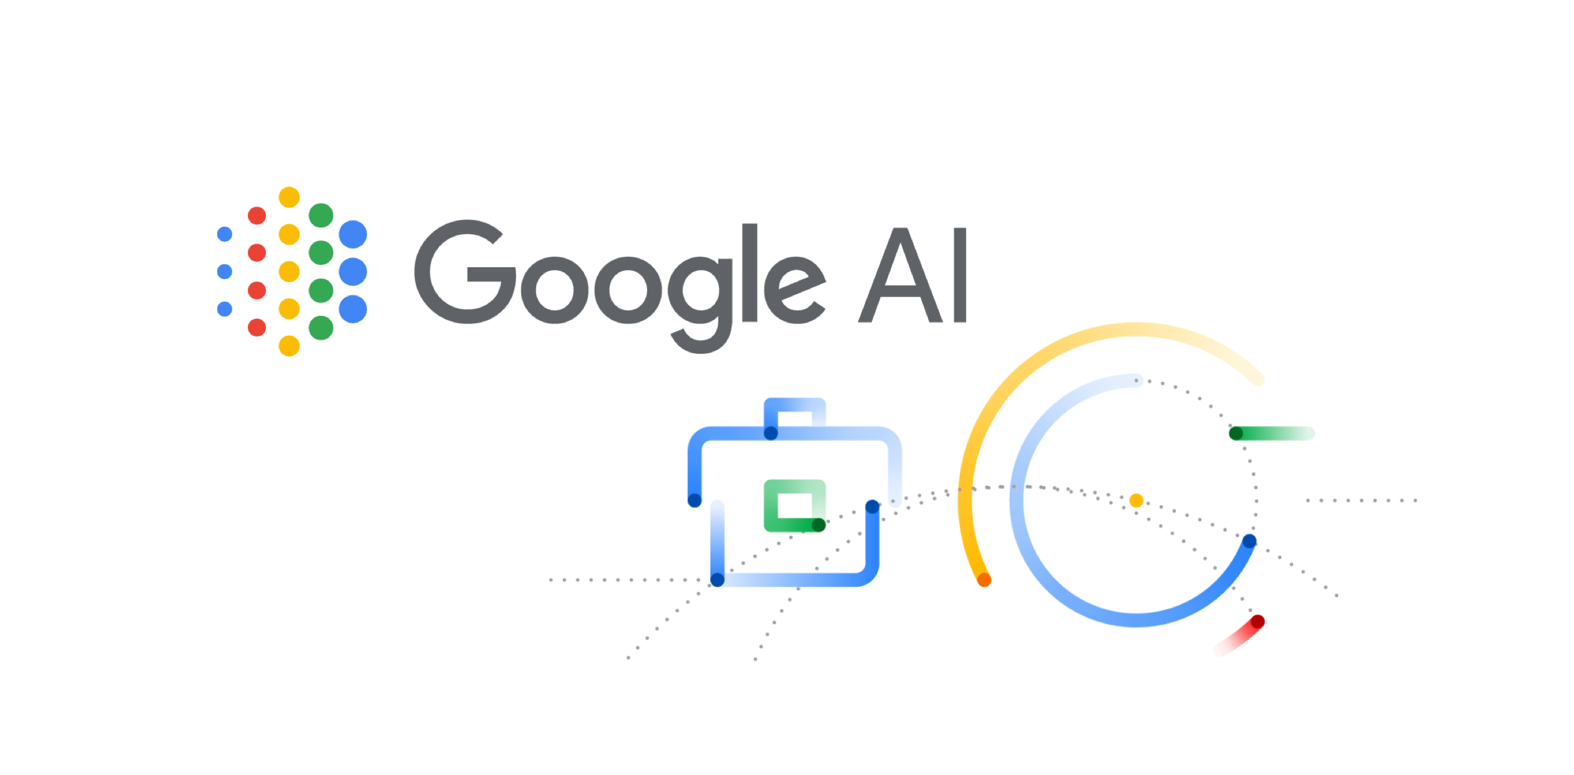



AI/ML PaaS (Platform-as-a-Service)
Microsoft Azure (Preferred)
Google AI Platform
Amazon AWS (Preferred)
IBM Watson
RedHat OpenShift
A code-based data science development environment whose focus is on machine learning. AI Platform allows teams to collaborate on ML projects from the dashboard within the cloud console.
Offers a large selection of tools and services. It also provides a set of ready-to-use APIs and allows you to generate your own APIs for integrating AI functionalities into your applications.
It is helping organizations across various industries to accelerate business and mission critical initiatives by developing intelligent applications in the hybrid cloud.
It offers a rich set of AI services spread across nine categories, from text comprehension to speech recognition to personalized recommendations for end users.
Can be used for solving tasks related to ML, computer vision, and language processing.

Slide 16
Resources
Training :
https://www.coursera.org/learn/machine-learning-with-python
Tutorials:
https://www.tutorialspoint.com/machine_learning_with_python/machine_learning_with_python_regression_algorithms_linear_regression.htm
https://towardsdatascience.com/machine-learning-for-beginners-d247a9420dab

Slide 17
Basic Code Templates
Framework to understand and run end to end ML Steps:
https://github.optum.com/paymentintegrity/ML-BOOT.git
Raw Data Collection
EDA
Feature Engineering
Model Building and Evaluation
Model Deployment
Model Monitoring
Notes:
Add in Techno Leader slide deck as well.

Slide 18
AI/ML Use Cases, Starter Kit and Deployment Strategy
Sample Project
Finding Donors
Optum Use Case and implementation details
COB Primacy Determination
Provider Call Prediction
Model Deployment Strategy
All the details are available at below link:
https://github.optum.com/agupt38/reuse_aiml

Slide 19
Thank You
Alok & Mansi
Please join our Microsoft Teams channel , IndiaAI Guild, pinned on the chat for more training information

